Slide 1
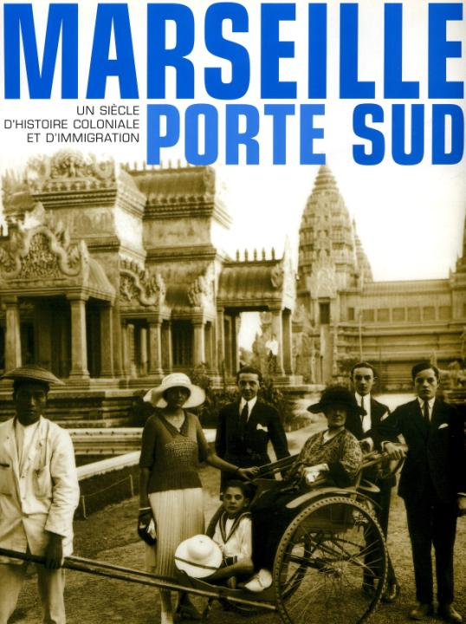

Slide 2
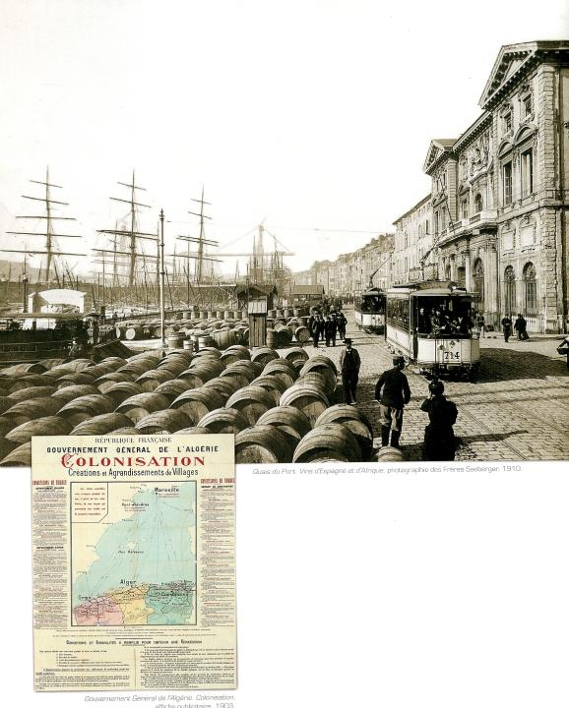
During the 19th century,
France conquered a very big empire and had numerous colonies in Africa and Asia.
Marseille is the heart of the French colonial empire because of its position, its harbour capacity and its nearness to North Africa.

Slide 3
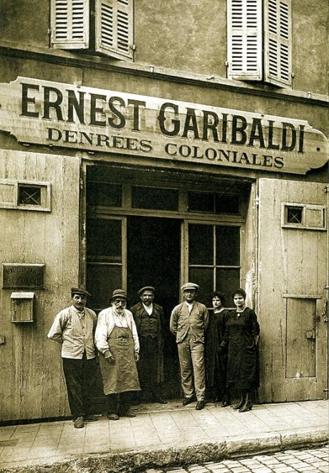
At the beginning of the XXth century, its trade represents 25% of the colonial imports and 48% of the colonial exports. North Africa supplies half of the weight of the colonial goods imported in Marseille. Algeria sent some wheat, wine, fruits and whool. In the exports from Marseille to the colonies, the superiority of North Africa asserts itself even more : products are materials of construction, some coal …
The exports represents from Indochina are rice, pepper and tea ; from Antilles, sugar and rum and from West Africa, groundnuts,cocoa…

Slide 4
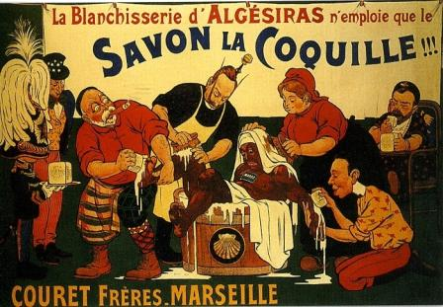
One product makes the synthesis between the colonial actuality of the beginning of the 20th century and the local economy: it is the soap called « la coquille » (the Shell).
In 1906, a poster is inspired by the Algesiras conference where the European divided Morocco : the king of England Edward VII, the Emperor of Germany Guillaume II, Marianne representing France and the King of Spain Alphonse XIII, who wash a black man representing Morocco. The King of Italy, Victor Emmanuel II, presents the soap and the Czar Nicolas II licks the soap of his Child’s hair.

Slide 5
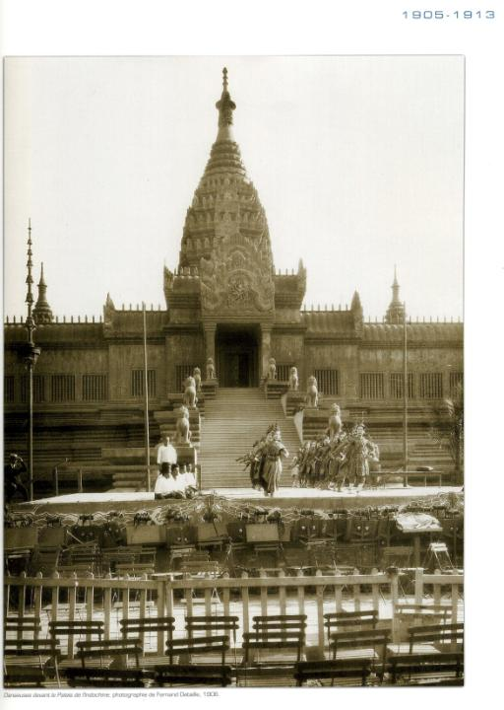
In 1906, the organisation of a great colonial exhibition confirms the ambition to be the capital of the french colonial empire. This exhibition took place in the Chanot Park.
There is a reconstruction of one of the towers of Angkor Vhat temple where, on a majestic staircase, Indochinese dancers appear.
We can also see a West African village with a mosque, huts and sheds sheltering animals like zebus, cows from Guinea and oxen from Ivory coast.

Slide 6
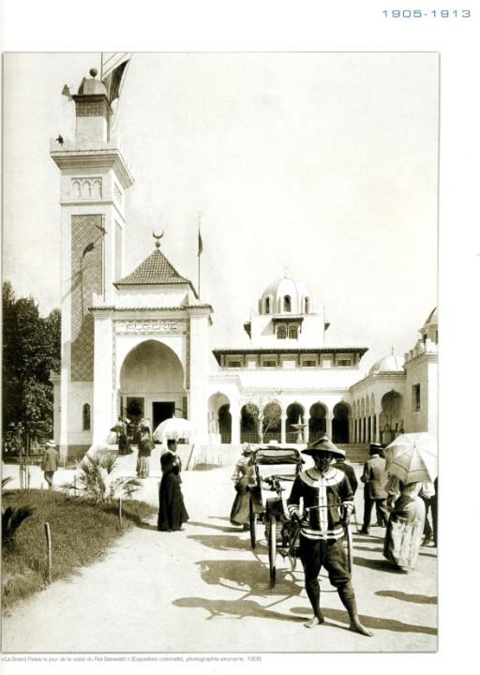

Slide 7
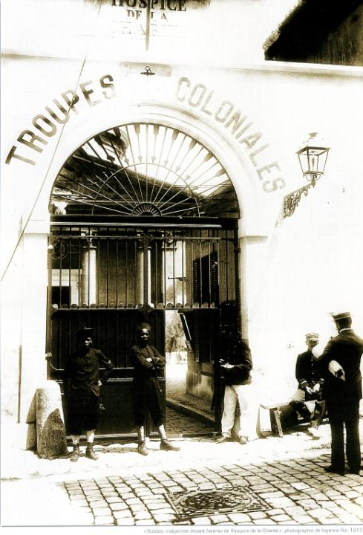
During the first world war, France
asked to the inhabitants of the colonies to fight for France.
A lot of them arrived in Marseille in 1914 and the « Vieille Charité »(Old Charity), an ancient place of confinement for beggars was transformed in barracks for colonial soldiers. They were subject to a health control and to a short military training.

Slide 8
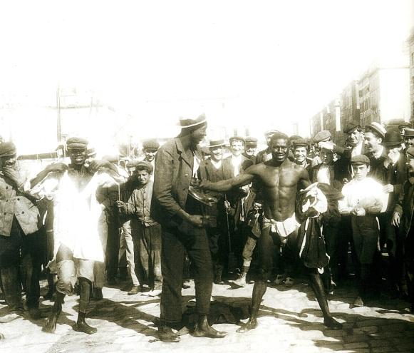
Between the two world wars, numerous inhabitants of the colonies were present in
Marseille. Often, they were dockers there. Often accomodated pitifully, they undergo the ostracism of their french colleagues and they do the most painful jobs such unloading sulfur, driedfish and coal.

Slide 9
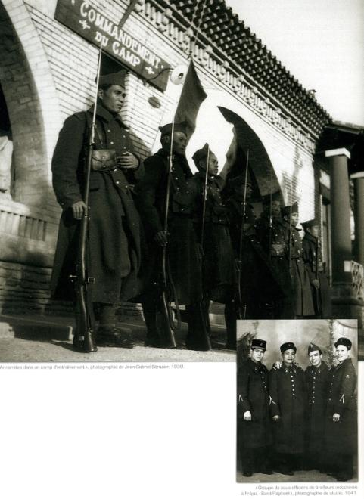
During the 2nd world war, France asks the inhabitants of its colonies again to fight with the French against Germany.
German think Marseille is an impure city with a threatening cosmopolitism.
In August 1944, African Army releases the south coast of France

Slide 10
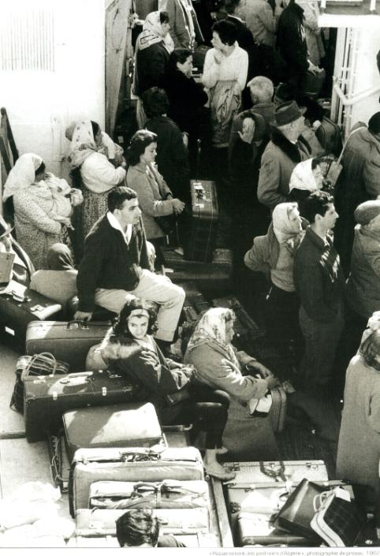
After the war, it is the indépendance time.
With the end of Algeria such as french colony , the biggest exodus of rapatriates to Marseille begins.
So, in 1962, more than one million persons arrive from Algeria and, for the greater part, they pass by Marseille which is the city in France that fells most directly the collapse of colonial empire.

Slide 11
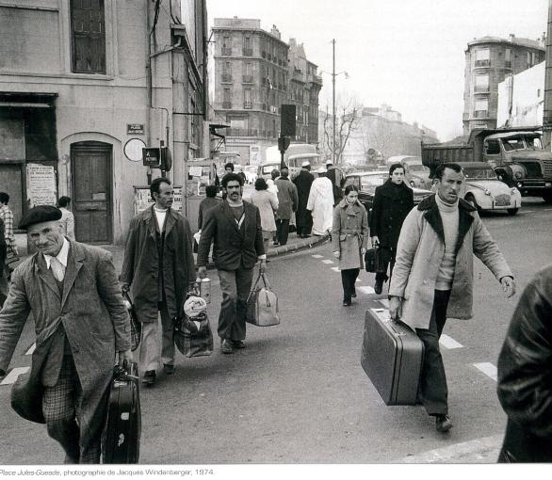
During sixties and seventies, numerous migrant workers from the ancient colonies arrive in France and most of them pass by Marseille. The family politic explain increase of the immigrated population between 1975 and 1982. Beside North African people, one other community didn’t stop to become more and more important in Marseille: it is the migration from Comoros

