Slide 1
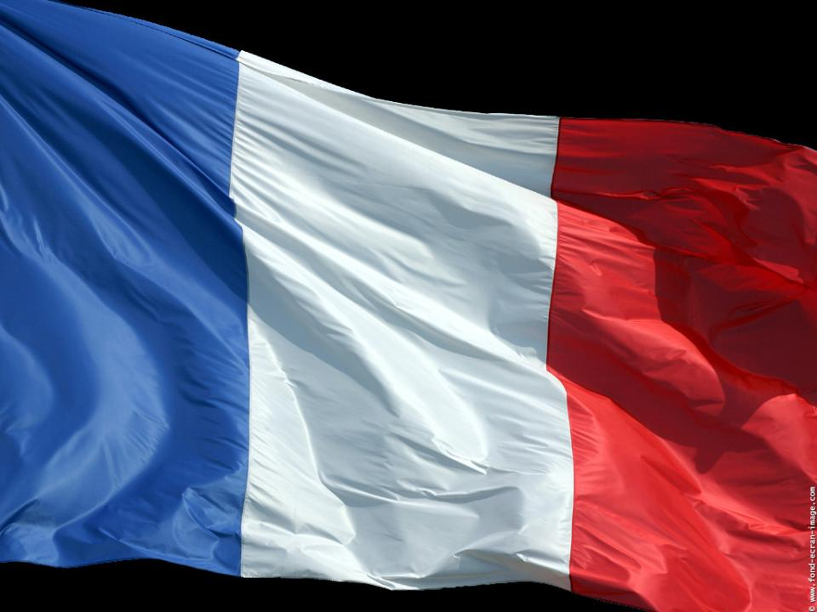

Slide 2
Marseille, La Provence et la France.

Slide 3
MASSALIA
During the Antiquity, the Greeks settled down on several locations of our Mediterranean coast. Then in - 600 years before J-C, some Greeks coming from the city of Phocée in Asia Minor created Massalia.

Slide 4
The Romans integrated our territory, the Gaulle into their empire.
At that time, the Romans created Aquae Sextiae ( Aix en Provence), Arles, Orange, Nimes where they left lot of remains which show the big prosperity of our region.
Arles

Slide 5
Amphithéâtre d’Orange
Le pont du Gard

Slide 6
At the end of the Vth century, people coming from the east, called the Francs, settled down in this part of the Roman Empire called the Gaule and which became the kingdom of the Francs.
The Franc state has been built with a monarchy and various dynasties succeeded one of another from the Vth to the XVIIIth century.

Slide 7
The kingdom of Provence was created in the middle of the IXth century, and at the beginning, was not linked to the kingdom of France.
It is only at the end of the XVth century that Provence linked to the France.
One of the last very famous count of Provence is king René.
Today a small candy sweet called “Calisson”wear his name
The presence of the Popes in Avignon, called "Pope city“, in the XIVth century,has distinguished the Provence.
Statue du Roi René à Aix

Slide 8
La cité des Papes

Slide 9
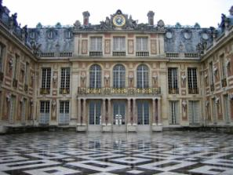
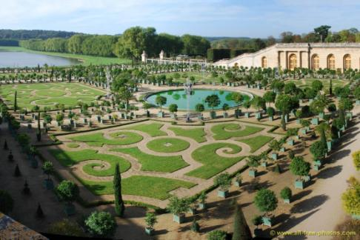
King Louis the XIVth, the most known king of France,
( 1661-1715 ) built the very famous Palace of Versailles.

Slide 10
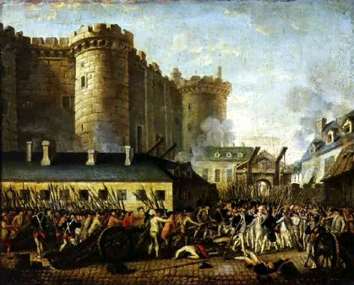
In 1789 takes place a big Revolution which achieves the absolute monarchy: the king gets all the powers and the French must obey without protesting.
La prise de la Bastille

Slide 11
The revolution gives birth to the writing of a big text: " “Human and citizen rights declaration " who advances the principles of liberty of thinking and equality of rights.

Slide 12
And so a new political system is born: the Republic.

Slide 13
The unhabitants of Marseille became famous during this event when they defended Paris attacked by Austrians. During their trip to Paris, they were singing " the Rhin’s war army song " renamed afterwards
"La Marseillaise".

Slide 14
In 1799, Napoleon Bonaparte took the power and during the first empire (1804-1815) he extends revolutionary experiences to the all Europe with the introduction of “the civil code”

Slide 16
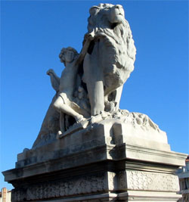
An important moment of the France history in the XIXth century is the construction of the immense French empire in Africa and in Asia.
Marseille plays a big part as “Orient’s gate”.

Slide 17
At the beginning of the XXth century, in 1905 was voted a law establishing the principle of secularism which is a French specificity in Europe and which consists to separate politics and religion.

Slide 18
In the XXth century, France was touched by 2 world wars like other countries of Europe.
During summer 1944 as the rest of the territory, the Provence was free from the “Nazi occupation”
On « Notre Dame basilic », still remains the impacts of figths.

Slide 19
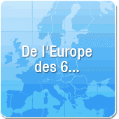
In 1957, France, with Germany, both generated the European rebirth. All countries of this union can cooperate and have commons projects!!!

Slide 20
Habits in Provence ….

Slide 21
Les chansons françaises

Slide 24
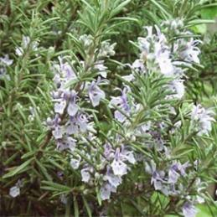
Provençal gastronomy is a delicious mixt of fruits and vegetables such as tomato or " toffee apple “, zucchini, eggplant, pepper, olive (or olive oil) and all of this, perfumed with the famous mixed“Herbes de Provence”.

Slide 25
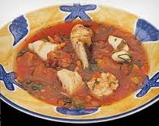
Certain dishes are typical of our region
Bouillabaisse is a greek antic meal. At the begining, a simple fish stew called Kakavia, cooking with unsolde fishes bring by fishermen.Bouillabaisse appears as well in Roman mythologie, as a soup prepared by Venus to send to sleep his husband Vulcain, in order to go out with Mars.

Slide 26
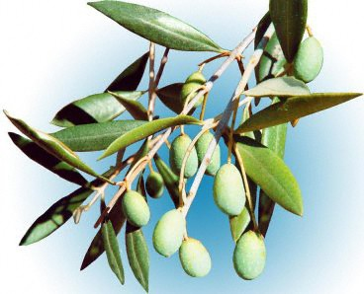
The tapenade ( olives and capres smached into a paste) is the star of a sophisticated apéritif in Provence.
Olives (green or black) are very used in the Provencal cooking and we find it on all the Mediterranean region.
Olive tree is traditionally considered as the typical species of the Mediterranean region. All the civilizations following one another in the region shared its story with Olive tree.

Slide 27
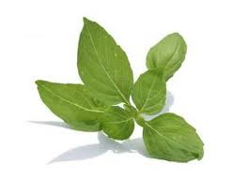
The aromatic plants are used, since the Antiquity, as essentials oils, , in bargaining chip, in medecine, in food industry. You can buy it : fresh, dry, deep-frozen, in extracts. About hundred of differents species that developpe the spécial taste of the Provencal cooking.The most known are the thyme, farigoule, the rosemary, the basil, the sage, the laurel, the tarragon, the marjoram or the oregano, the fennel, the wild thyme.

Slide 28
.
Out for a walk in Provence, the smells of these famous herbs such as the thyme, the rosemary or lavender stands out to your nose.

Slide 29
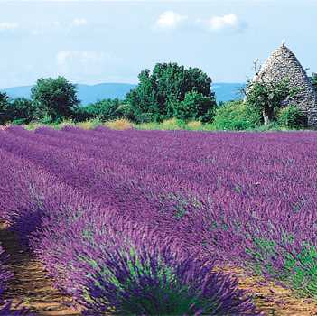
Out for a walk in Provence, the smells of these famous herbs such as the thyme, the rosemary or lavender stands out to your nose.
The blue lavander fragrance is every where in Provence. It is used in pastry, ice-cream, home fragrance...cleaning products, and in little bag you can keep it in your linen or cupboards. Lavander is one of the most famous fragrance which remind the Provence

Slide 30
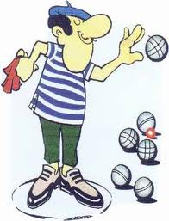
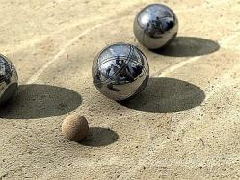
Provence conceals very good wines. Apéritif is the moment you can appreciate good rosé wine or Pastis which is an alcoholic drink produces by the maceration of plants (anise, licorice); the apéritif can come along with a « Petanque » which is a famous bowls game or by looking at OM match, very famous footballclub from Marseille.

Slide 31
